Slide 1
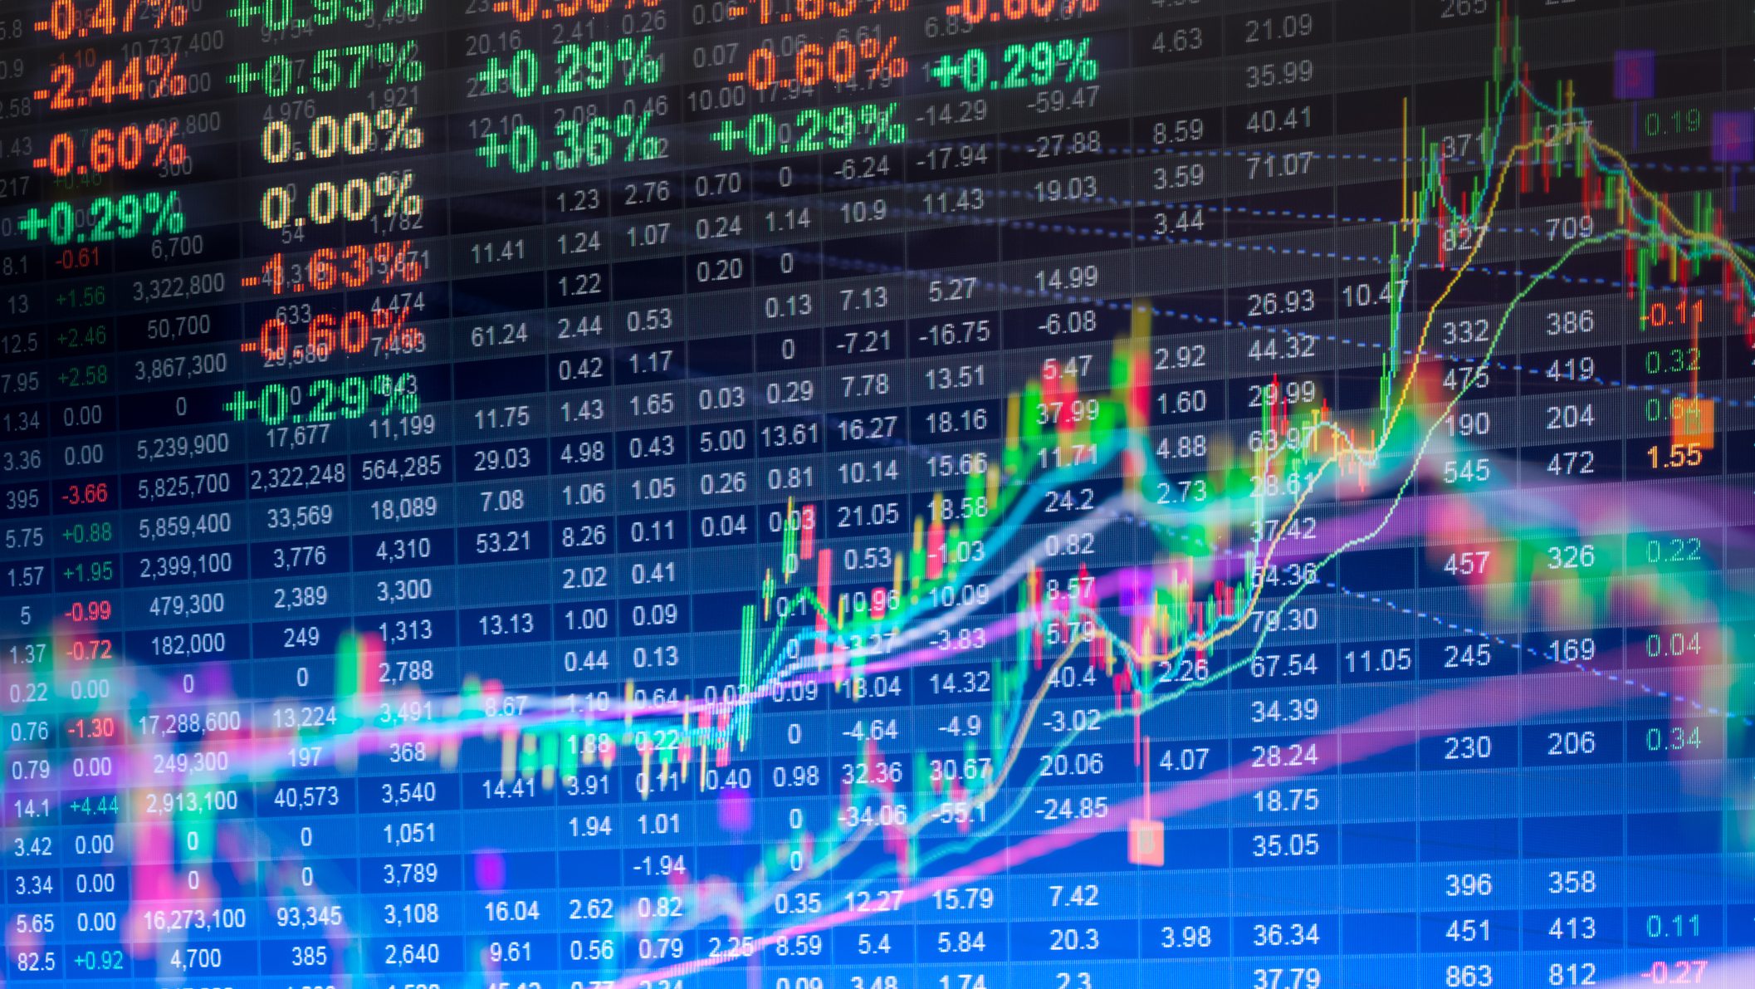
Stock prediction
Written by: Adi Tzipori

Slide 2

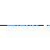
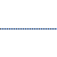
Research question
Can we predict when and how much a stock will rise or fall?
How can we predict and what conclusions can be drawn from the prediction?
Which machine learning model is better for the prediction?

Slide 3

Data sources
I used Yahoo Finance's built-in API.
I wrote a script that runs Over the DB and retrieve all historical data by dates.
We can get the data for every stock we chose by select the symbol of the company(example: tesla motor company = TSLA).
Finally, I chained the result to a data frame

Slide 4

Data cleaning
Threading of all the information to one table.
Filter incorrect values and
Remove duplicates if and exist.
Outline handling.
Arranging the format of the dates.

Slide 5

ML - machine learning
I used 3 models with 10,0000 data to predict the if the stock will rise or fall.
It is now possible to see which model is more predictable.
I returned the errors of each of the models.

Slide 6
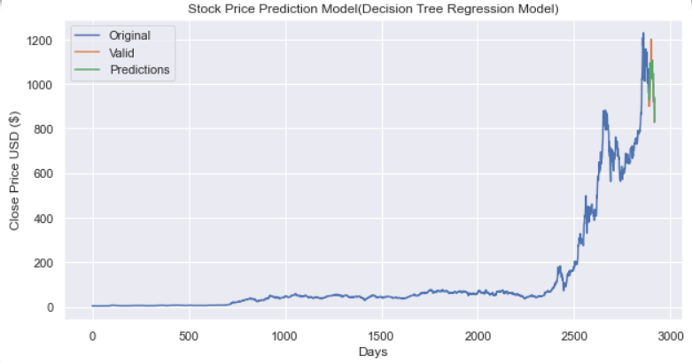
Decision tree model

Slide 7
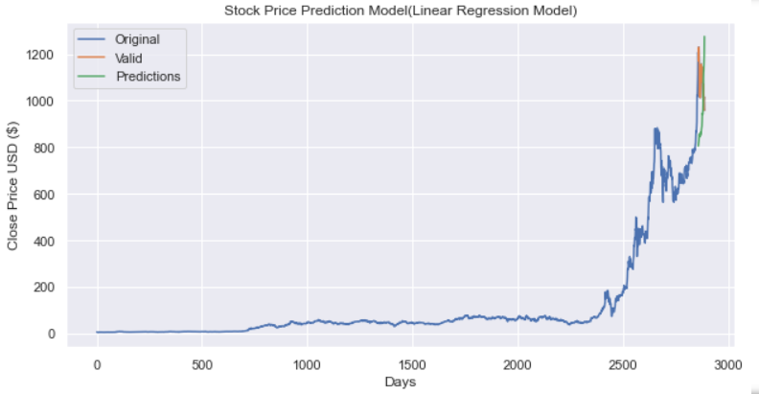
Linear regression model

Slide 8
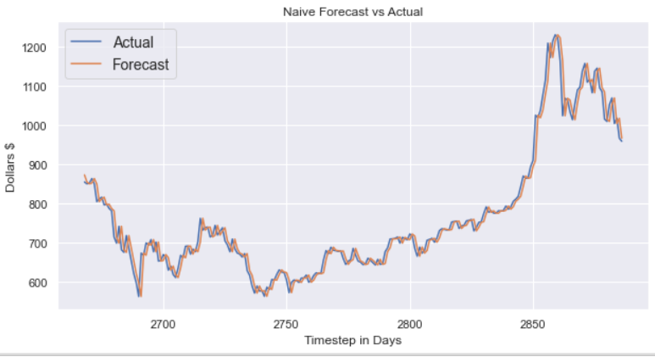
Naïve model

Slide 9
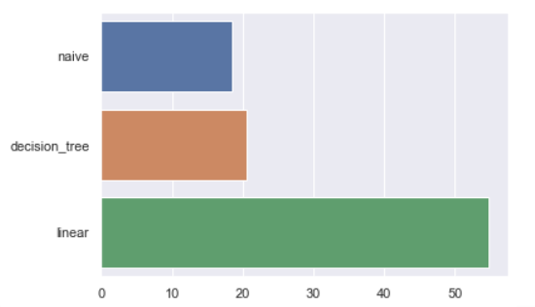
Average error models tested

